Slide 1
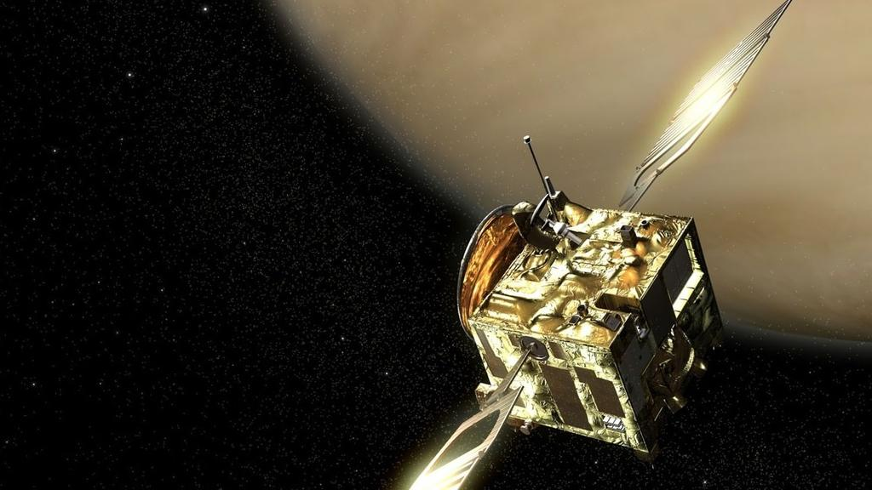
Venus Magnetosphere Data Analysis
Elysia Lucas
ASTR 4840
Fall 2018

Slide 2
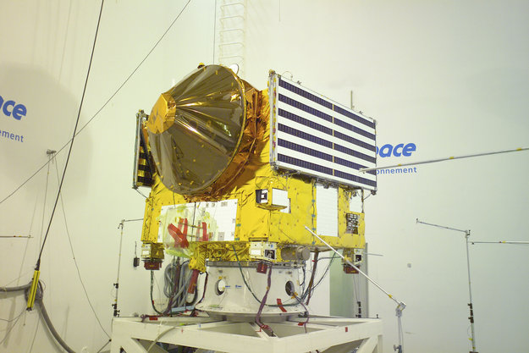
Venus Express Mission
ESA mission that collected data between April 2006 and November 2014, looking at the ionosphere + atmosphere + magnetosphere of Venus
Magnetic field data collected by 2 magnetometers – one on 1m outboard boom, one 10cm off spacecraft bus, accuracy ~0.5nT
Data comparison by sensor on spacecraft bus and sensor on boom allows for noise removal (due to reuse of the MEX bus which wasn’t ‘magnetically clean’)
We will be using calibrated L3 data, which is taken at a 1s cadence

Slide 3
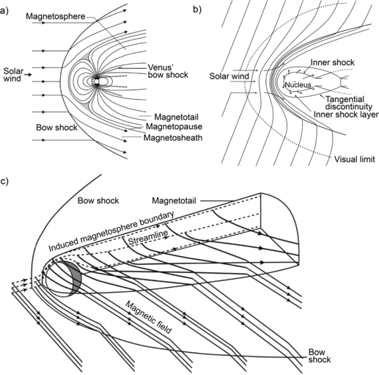
Venus’ Magnetosphere
Solar radiation will hit neutral particles in Venus’ atmosphere, ionizing some of them. The gyration of these ions will create a small magnetic field, since a magnetic field is created via moving electric charges.
The solar wind, comprised of ions, will also carry a magnetic field with it, which then will collide with the magnetic field created by the ionosphere. From here, field draping will occur since the ionosphere with a convecting magnetic field will prevent the field from the solar wind from reaching Venus.
The bow shock will be formed upstream due to deflection from the induced and draped magnetic field lines. Boundaries are based on the balance of P_{dyn}, P_{th}, and P_{B}.

Slide 4
What we should expect to see
The B-field will be minimal outside the bow shock, with low noise. When VEX passes into the area between the bow shock and the magnetosheath, this area will be particularly noisy (due to wave activity), and an increase in |B| can be observed. Inside the magnetosheath, the B-field will again be minimally noisy, and will approach a maximum B value. In addition, it should be noted that the various boundaries will be higher during solar maximum, when an increased amount of EUV solar radiation causes more particles in the atmosphere to be ionized.

Slide 5
Why do we care about the magnetosphere?
Not a lot of research has been done about Venus’ magnetosphere and its interaction with the IMF
Venus is typically difficult to study due to the cloudy and volatile atmosphere
Venus’ magnetotail is an incredibly dynamic region, and studying the magnetosphere here can offer insights on atmospheric escape and possible habitability, as the ions are blown off the planet
We will be ultimately looking at how upstream IMF conditions (high/low solar wind pressure, etc) affect the draped magnetic fields around Venus
We can also compare Venus’ magnetosphere and Mars’ magnetosphere, since they are similar in the fact that neither have native magnetic fields produced from the rotation of a molten core – they are only induced/crustal (in Mars’ case)

Slide 6
Current Underlying Assumptions/Data Facts
Orbital Period: ~24 hrs
Venus located at (0,0,0) VSO/VSE
Venus radius: ~6051.8 km (assumed perfectly spherical)
Data in VSO coordinates
L3 calibrated data

Slide 7
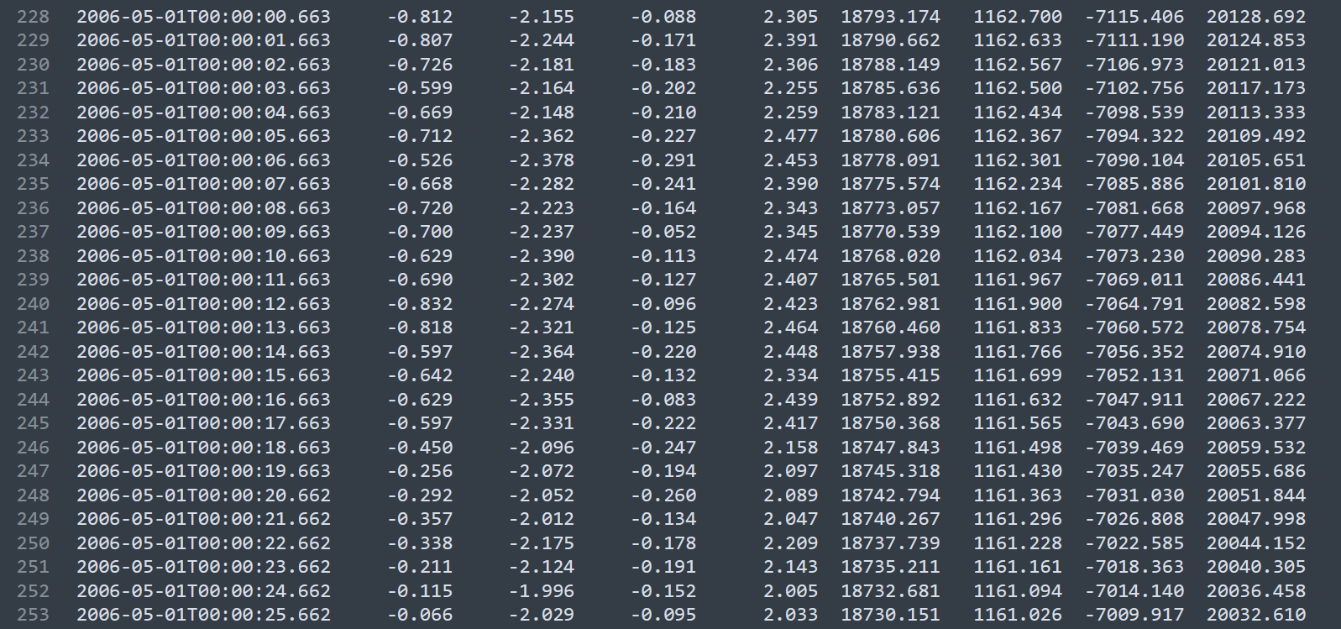
What does the calibrated L3 data look like?
nT
km
Time (UTC)
B_{x}
B_{y}
B_{z}
|B|
XSC
YSC
ZSC
RSC

Slide 8
Plotting the Raw Data
Excluded first 227 lines of header, then read all data into Pandas DataFrame with corresponding column headers
Made UTC column a DateTimeIndex for time series plotting
Removed nonsense data
newText=f.read().replace(':60.000', ':59.999') #replaces instances of 60s with 59.999s
table[(table>=99999)|(table<=-99999)] = np.nan #replaces any outliers with NaNs
Used matplotlib.pyplot to plot location data in Cartesian coordinates

Slide 9
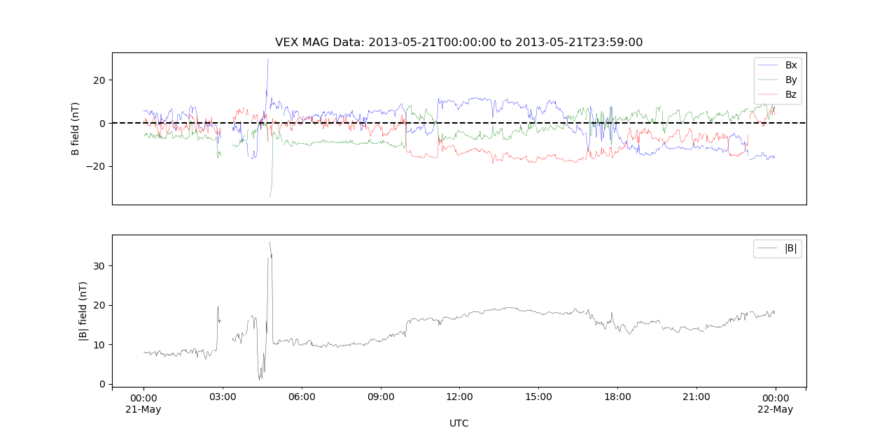
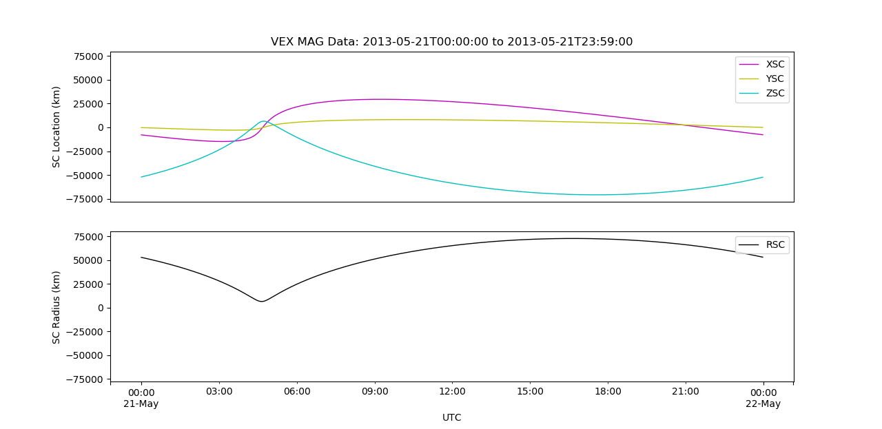
As VEX enters the area between the bow shock and the magnetosheath, we can see that the magnetic field data becomes stronger and has more noise.
In the magnetosheath, the data becomes less noisy and approaches a max B value.
We also see a sharp increase in magnetic field strength at periapse. This is possibly due to magnetic field pileup in that area.
Raw Magnetometer Data
Bow Shock
Magnetosheath
Periapse
Notes:
Magnetic field pileup at periapse?

Slide 10
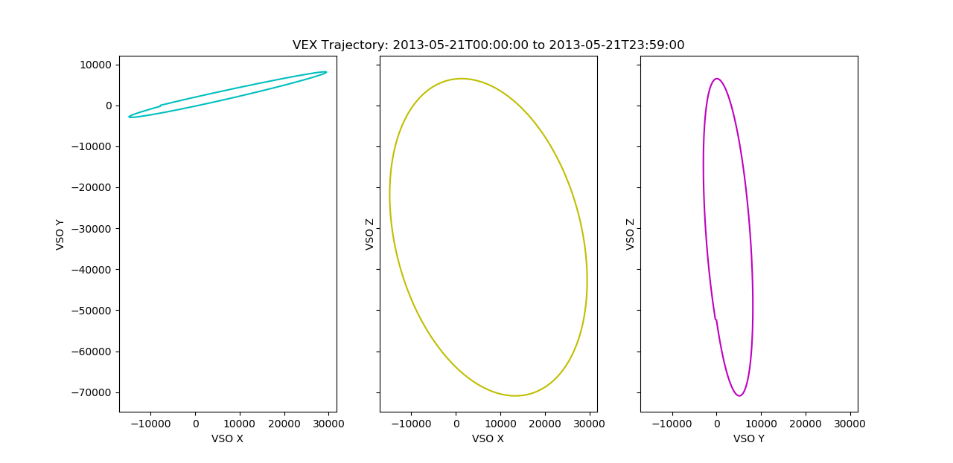
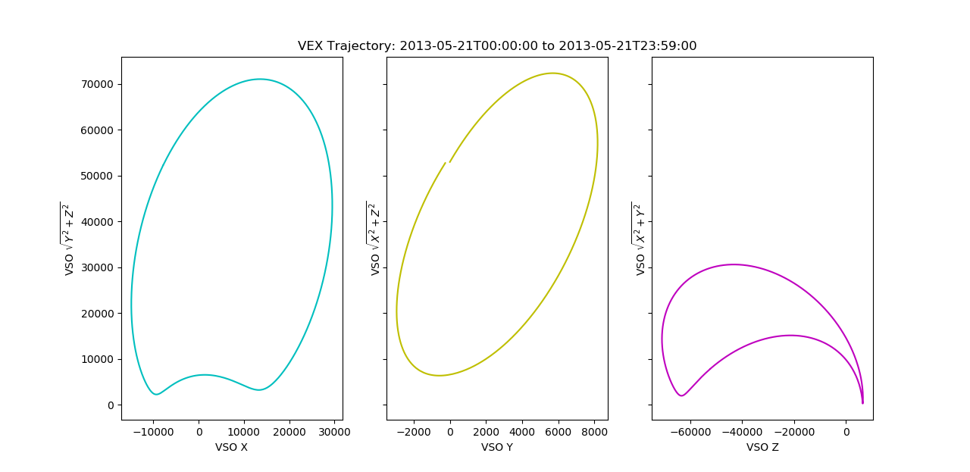
Single orbit plotted in Cartesian coordinate system
Visualizing Location Data
Single orbit plotted in cylindrical coordinate system

Slide 11

Superimposing Mag/Location Data
Plotted single VEX orbit around Venus
Rescaled from km to R_{V}
Downsampled data to 1 minute cadence
For each data point, plot magnetic field vector colored by strength in perpendicular direction (scale = 500 km/nT)
Martinecz research on location of BS and ion boundaries used to model BS for this project
$$BS= \sqrt{L^{2}−2εL\left(x−x_{0}\right)− {(ε}^{2}−1){(x−x_{0})}^{2}}$$
$$L=1.303$$
$$ε=1.056$$
$$x_{0}=0.788$$

Slide 12
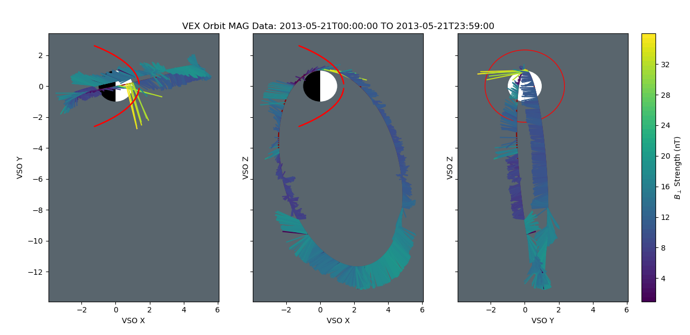
Location/Mag Data (VSO)
Magnetic field strength is low in the IMF, direction is mostly random
Magnetic field strength high closest to Venus within BS
Less variation in magnetic field direction within BS

Slide 13
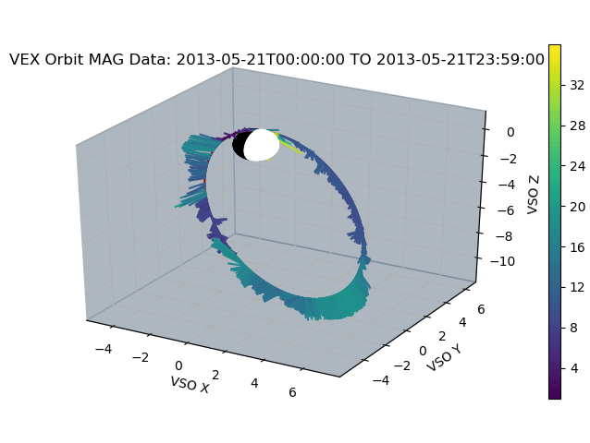
Location/Mag Data (VSO)
|B| Strength (nT)
3D representation of previous plots (bow shock not included)

Slide 14
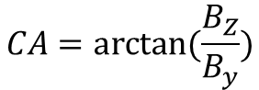
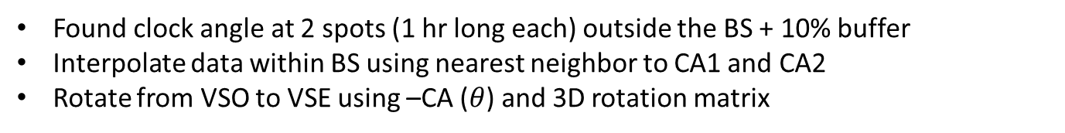
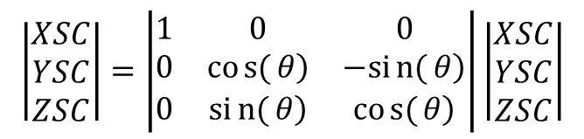
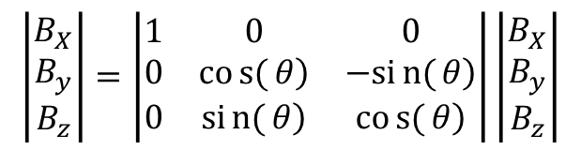
Rotating to VSE
$$CA=arctan⁡(\frac{B_{Z}}{B_{y}})$$
interpolate with CA2
CA2
VSE
Rotation Matrix
VSO
interpolate with CA1
$$\left|\begin{matrix}B_{X} \\ B_{y} \\ B_{z}\end{matrix}\right|=\left|\begin{matrix}1 & 0 & 0 \\ 0 & \left.cos{(}θ\right) & \left.−sin{(}θ\right) \\ 0 & \left.sin{(}θ\right) & \left.cos{(}θ\right)\end{matrix}\right|\left|\begin{matrix}B_{X} \\ B_{y} \\ B_{z}\end{matrix}\right|$$
CA1
VSE
Rotation Matrix
VSO
$$\left|\begin{matrix}XSC \\ YSC \\ ZSC\end{matrix}\right|=\left|\begin{matrix}1 & 0 & 0 \\ 0 & \left.cos{(}θ\right) & \left.−sin{(}θ\right) \\ 0 & \left.sin{(}θ\right) & \left.cos{(}θ\right)\end{matrix}\right|\left|\begin{matrix}XSC \\ YSC \\ ZSC\end{matrix}\right|$$
Found clock angle at 2 spots (1 hr long each) outside the BS + 10% buffer
Interpolate data within BS using nearest neighbor to CA1 and CA2
Rotate from VSO to VSE using –CA ($θ$) and 3D rotation matrix

Slide 15
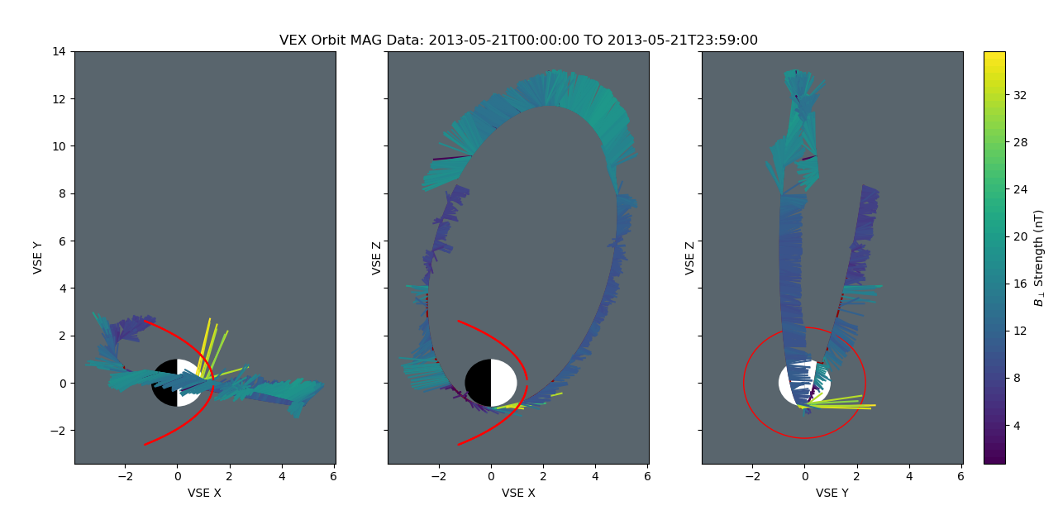
Location/Mag Data (VSE)
We can see the magnetic field vectors are aligned with the Y axis in the Y vs. Z plot; therefore the rotation is most likely correct. We can also check this by overplotting just the Bx magnetic field data in the YZ plane.

Slide 16

Checking the VSO to VSE Rotation
Take nightside slice between -1 R_{V} to -2 R_{V} XSC
Scatter YSC vs ZSC data, colored by B_{x} (- blue, + red)
Overplot each orbit of data
We should see the magnetic field split left/right, with positive on the left and negative on the right, since the IMF lines will wrap around Venus
The plot will show the -1 to -2 R_{V} slice on the nightside
IMF Propagation
Direction

Slide 17
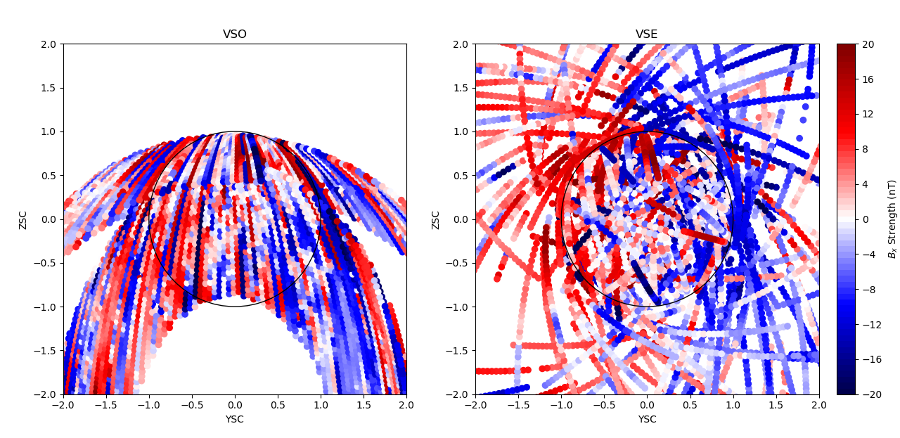
VEX Nightside Data: 2013-05-07 to 2014-05-07
VSO and VSE Comparison
We can see that when rotated to VSE, the magnetic field is split left/right, which aligns with what we expected. Let’s plot it for a longer timescale to double check.

Slide 18
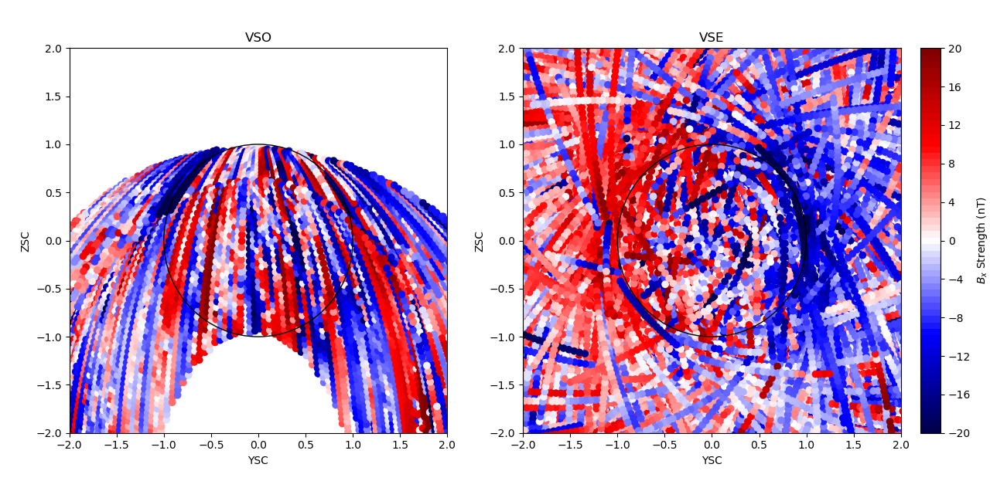
VEX Nightside Data: 2006-04-24 to 2014-11-25
VSO and VSE Comparison
In this VSE plot, it is very clear that there is a delineation between the positive and negative lobes of the magnetotail, so we’ve done the rotation correctly.

Slide 19
Binning the Data in VSE
Used pydivide.bin to bin each magnetic field vector (B_{x}, B_{y}, B_{z}) by the spatial dimensions (XSC, YSC, ZSC) between -3 R_{V} and 3 R_{V}, using bins of 0.1 R_{V}
For each magnetic field vector, collapsed 3D binning on each x/y/z dimension (perpendicular dimension will be used for bin coloring) by taking mean
For each day, add to final 2D array, divide by total number of non-NaN values in each bin (1 NaN per bin per orbit with no data)

Slide 20
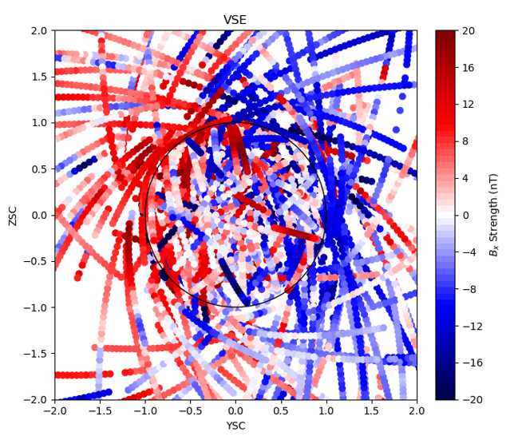
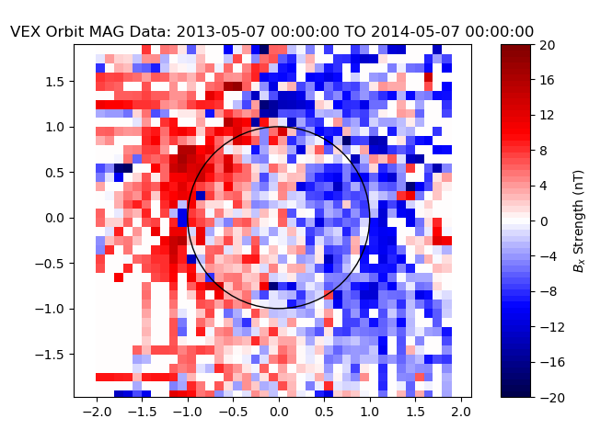
VEX Nightside Data: 2013-05-07 to 2014-05-07
VSE Overplot vs. VSE Binned
ZSC
YSC
As you can see here, we should expect these two plots to look nearly identical when binned, because it is the same data but just averaged instead of overplotted.

Slide 21
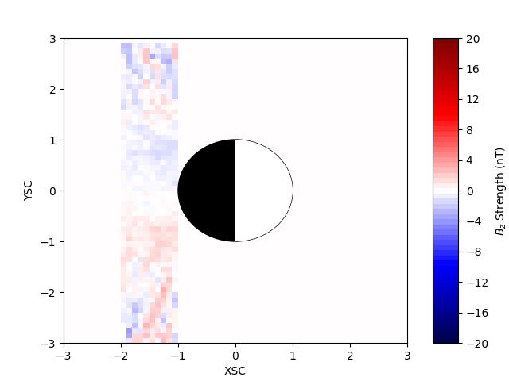
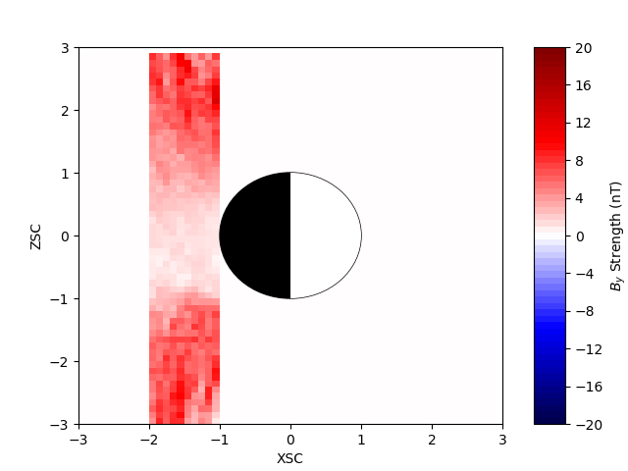
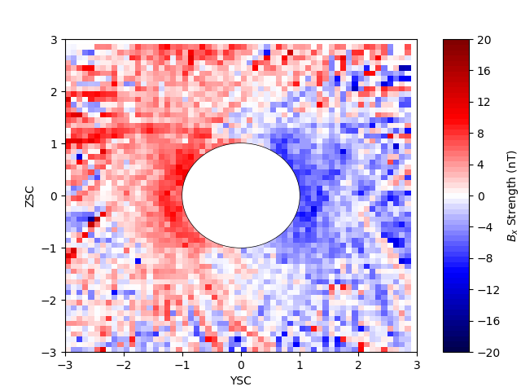
VSE Binned Data: Nightside Only (-1 R_{V} to -2 R_{V} XSC)
2006-04-24 to 2014-11-25
Binning the nightside data over the full time range yields very similar plots to the 1yr plot shown previously. The XY and XZ plots consist of strips on the nightside of the planet due to filtering the data between -1 and -2 Venus radii before binning.
We still see the left/right magnetic field split in the YZ plot, so we know that our rotation continues to be correct for all included data.

Slide 22
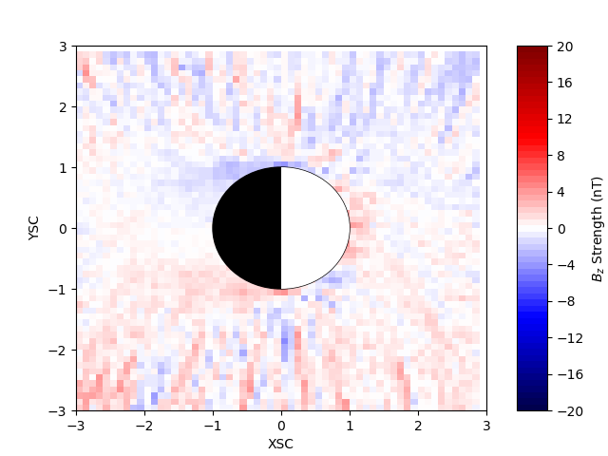
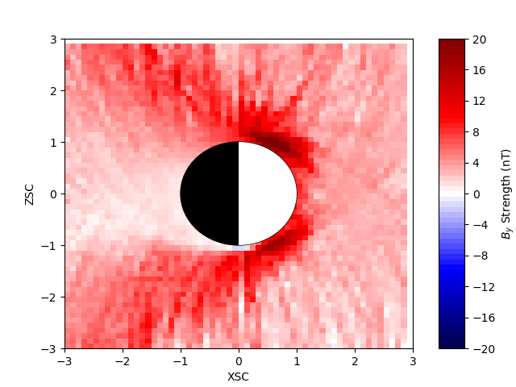
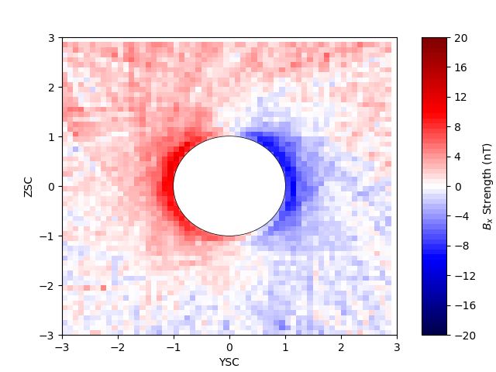
VSE Binned Data: Dayside and Nightside
2006-04-24 to 2014-11-25
Including both the dayside and nightside data allows us to more clearly see the magnetic field structure around Venus. As seen in the XY and XZ plots, the magnetic field is stronger in a parabolic shape around the planet and much weaker directly behind the nightside, due to its minimal interaction with any of the IMF. Let’s superimpose magnetic field vectors to more clearly see this structure.

Slide 23
Visualizing Magnetic Field Vectors
matplotlib.quiver was superimposed onto the binned collapsed data (Ex: Bz for XY), given the other two magnetic field binnings for the slice (Ex: Bx and By for XY)
The meshgrid was shifted so that vectors would appear in the center of each bin instead of the bottom left
The vectors indicated magnetic field direction and relative strength as they are autoscaled – setting a scaling relation for this will most likely happen in the future

Slide 24
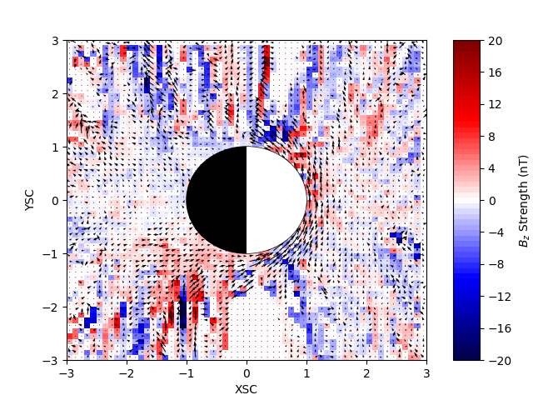
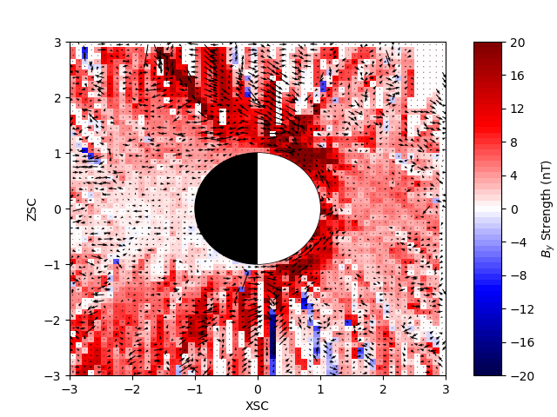
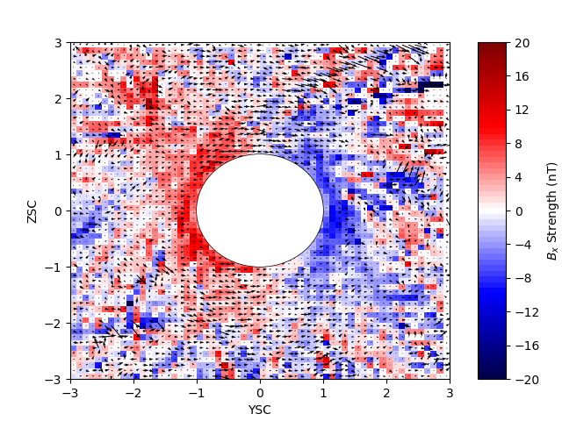
Magnetic Field Draping at Venus
2013-05-07 to 2014-05-07
In the XY plot, we can see that out in the IMF (+x), the magnetic field directions are mostly random. However, near the dayside of Venus, we can observe the IMF draping around the planet, due to its interaction with the induced magnetic field. Behind Venus, we should expect little magnetic field interaction due to this draping, which is confirmed with the low field strength indicated by the plot. We see similar interactions in the XZ and YZ plots as well.
There seems to be a lot of interesting phenomena in this data, visible in XZ around (-1.5,2) and in YZ around (1.5,2.5) that will require more analysis.
Notes:
talk about observations, possible reasoning, draping

Slide 25
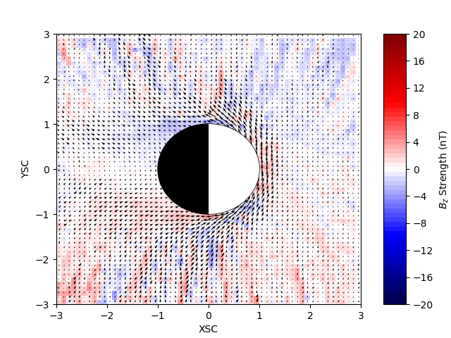
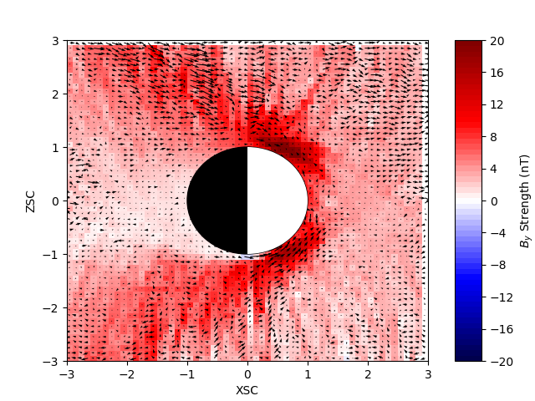
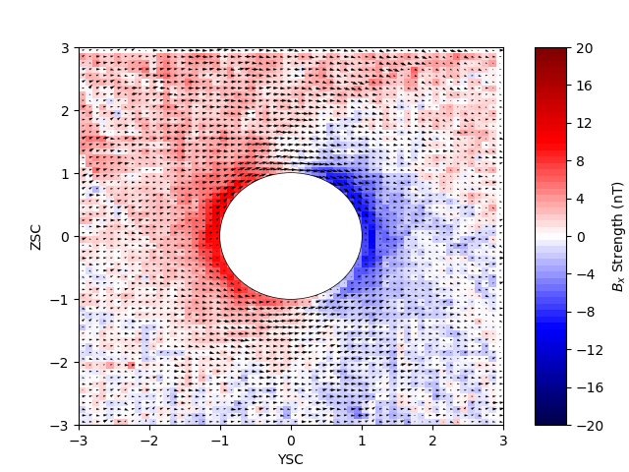
Magnetic Field Draping at Venus
2006-04-24 to 2014-11-25
In these plots run with all available data, the magnetic field draping is much more apparent, especially in the XY and YZ plots. We see that on average over the VEX mission, the field very clearly drapes from the dayside to the nightside, splitting polarity around the planet. If you look closely at the XY nightside, you can see draping reminiscent of a magnetotail, which is what we should expect.

Slide 26
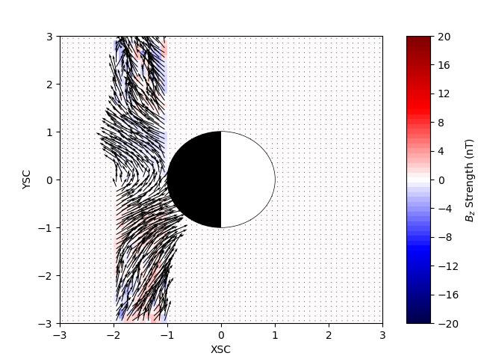
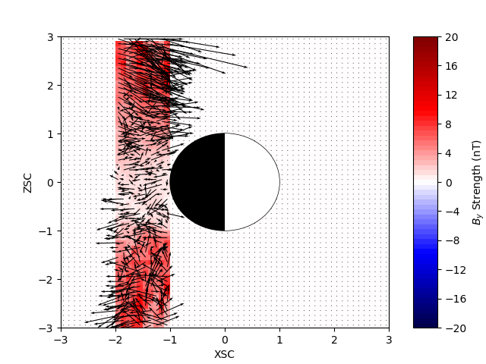
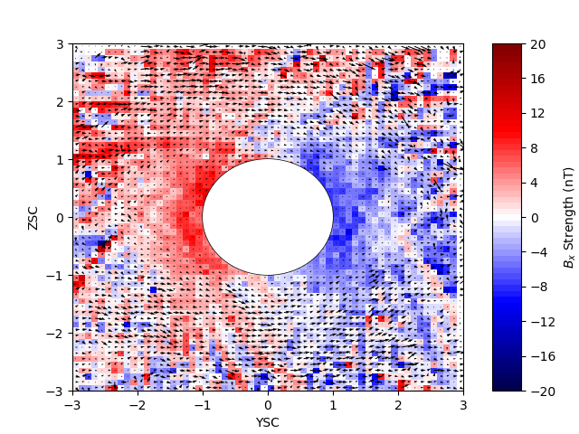
Magnetic Field Draping at Venus: Nightside
2006-04-24 to 2014-11-25
In XY, we clearly see a magnetotail structure formed behind Venus. In XZ, there seems to be a lot of chaos in the direction of the magnetic field vectors, but their relative strength indicate strong magnetic fields where we would expect draping, and weak magnetic fields directly behind the planet. In YZ, we see very similar vectors to the day/night plot in the last slide, pointing from the positive to the negative bins.

Slide 27
Discussion/Next Steps
We can clearly see magnetic field draping due to interactions between the IMF and Venus’ magnetosphere
We can see this both in the vector field and in the bin coloring of the rotated VSE plots, which means that our method of binning and rotating from VSO to VSE worked well enough
To make this more accurate, we might try a different interpolation scheme instead of ‘nearest neighbor’ for the coordinate rotation, or do a more clear weighted average by keeping track of the number of data points in each bin per orbit instead of counting one orbit with no NaNs as ‘1’ and NaNs as ‘0’ (use pydivide.bin w/ counts=True)

Slide 28
Discussion/Next Steps
To see how the magnetic field changes over time, it might be interesting to bin one year at a time and create a .gif to visualize it
Another way to visualize the dynamics and structure of the magnetosphere is to get a list of upstream conditions/times, and see what happens under various types of conditions
We could also compare Venus’ magnetosphere to Mars’ magnetosphere in order to maybe gain more insight about ion escape and how the magnetosphere structures compare
Some of the file IO code needs to be rewritten for robustness, and each piece of code will be re-examined or restructured to make sure there are no code errors and that they are operating as efficiently as possible
Notes:
Add reasoning

Slide 29
Write nested for loop pseudocode
2 hrs maximum for coding
Color by |B| for XSC vs YSC
Decide what I want to show to be most informative
RUN NIGHTSIDE QUIVER PLOTS
RERUN ALL QUIVER PLOTS

